Slide 1

Cascading Style Sheets
CITS3403 and CITS5505 - Agile Web Development
Unit Coordinator: Maira Alvi
2025 Semester 1

Slide 2
CSS basics
Notes:
2

Slide 3
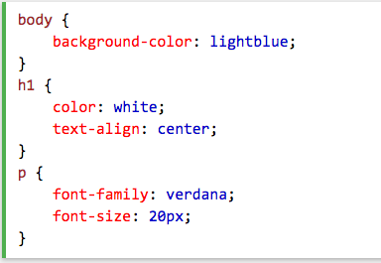
What is CSS
CSS stands for Cascading Style Sheets
a stylesheet language for the web
used to specify the presentation (layout and style) of markup languages
can be applied to any XML document as well as HTML.
superseded many HTML attributes that mixed presentation with content
Notes:
e.g., Bgcolor, font size, font face etc

Slide 4
Advantages of CSS
Separation of content and presentation
Advantages for the web
Speed - stylesheet(s) downloaded once, rather than with each page (if content and style information is intermingled).
Maintainability - can be “centrally” maintained, easier to update
Accessibility - pages appear similar on different browsers and devices.
Portability – consistent styling across all devices supporting browsers.
Reduced work – e.g., don’t have to specify alignment for every element.
Consistency - make an organisation’s web pages have a consistent “look and feel” that matches the corporate ID, brand - e.g., UWA...

Slide 5



Slide 6
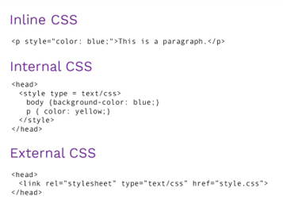
Why "cascading"?
There are three levels of style sheets
Inline styles – applies to a single tag only.
Document style sheets - appears in the document's <head> element and applies to the whole document.
External style sheets - separate files, potentially on any server on the Internet, and can be applied to any number of documents in their <head> element.
Notes:
The “cascading” in CSS refers to the fact that styling rules “cascade” down from several sources.
in line styles have priority over document level styles which have priority over external styles.

Slide 7
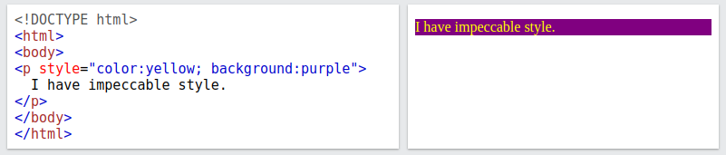

Inline styles
Style specification appears as the value of the style attribute of almost any tag.
General form: style="property_1: value_1; property_2: value_2; … property_n: value_n"
Example:
Warning: Inline styles defeats the purpose of style sheets i.e. uniform style. Use it for debugging but not much else!

Slide 8
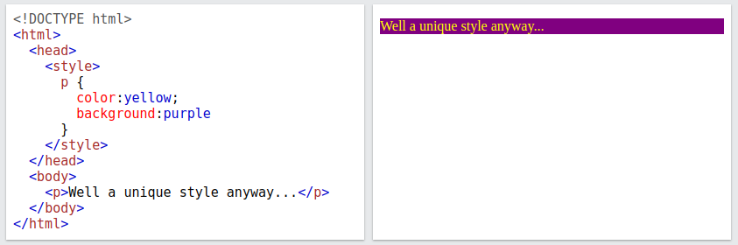
Document styles
Style specification appears as a list of rules that are the content of a <style> tag contained in the document <head>.
Specification form:
<style>
rule1
rule2
...
</style>
Rule form: selector { property1:value1; property2:value2; ... }
Property-value pairs are separated by semicolons, just as in the value of a style attribute.

Slide 9
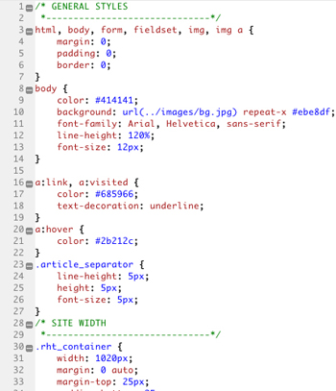
External styles
A <link> tag inside <head> is used to specify that the browser is to fetch and use an external style sheet file, E.g. Wikipedia style sheet
http://en.wikipedia.org//skins-1.5/common/shared.css?165
<link
rel="stylesheet”
type="text/css”
href="http://tiny.url/some.css">
</link>
The format is identical to the contents of a <style> tag for document-level style sheets.​

Slide 10
CSS selectors
Notes:
10

Slide 11
Selector basics
A selector determines which elements the style applies to.
There is a whole language for writing increasingly precise selectors.
There are broadly two types, basic selectors that allow selection based one specific criteria, and combinators that then allow one to join multiple criteria together in various ways.
Writing sets of CSS selectors that scale to large webpages and don't clash with each other is a skill!
Basic selectors | Example
Universal selector | * {…}
Element selector | p {…}
Attribute selector | [secret=“yes”] {…}
Class selector | .important {…}
ID selector | #1234 {…}
Pseudo-class selector | :onhover {…}
Pseudo-element selector | ::first-letter {…}
Selector combinators | Example
Group selector | s1,s2,s3 {...}
Descendant selector | s1 s2 {...}
Direct descendant selector | s1 > s2 {...}
Sibling selector | s1 ~ s2 {...}
Direct sibling selector | s1 + s2 {...}

Slide 12
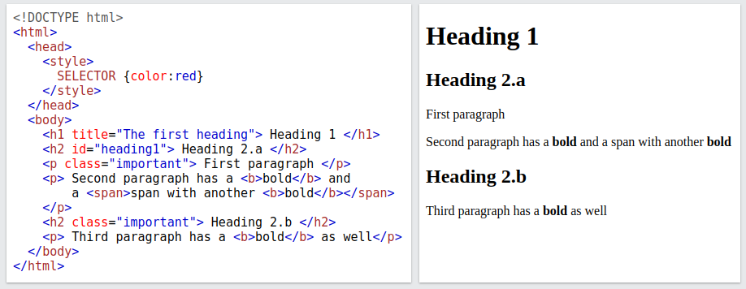
Selector example
To illustrate we will use the following HTML and CSS, replacing the "SELECTOR" as appropriate.
body
h1
h2
b
p
b
h2
p
p
b
span
<!DOCTYPE html>
<html>
<head>
<style>
[class="important"] {color:red}
</style>
</head>
<body>
<h1 title="The first heading"> Heading 1 </h1>
<h2 id="heading1"> Heading 2.a </h2>
<p class="important"> First paragraph </p>
<p> Second paragraph has a <b>bold</b> and
a <span>span with another <b>bold</b></span>
</p>
<h2 class="important"> Heading 2.b </h2>
<p> Third paragraph has a <b>bold</b> as well</p>
</body>
</html>

Slide 13
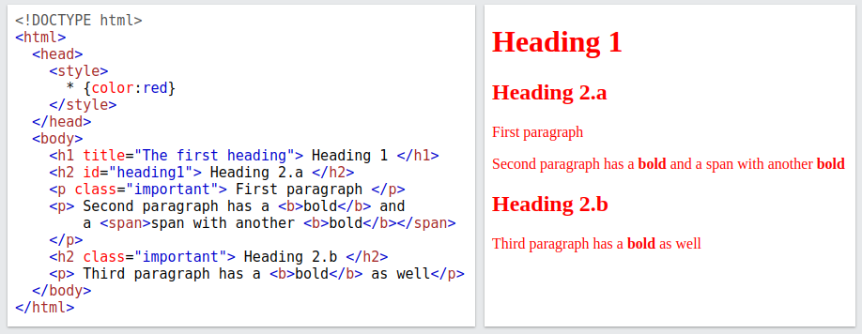
Universal selector: *
The universal selector * matches all elements.
Matching on * results in:
body
h1
h2
b
p
b
h2
p
p
b
span

Slide 14
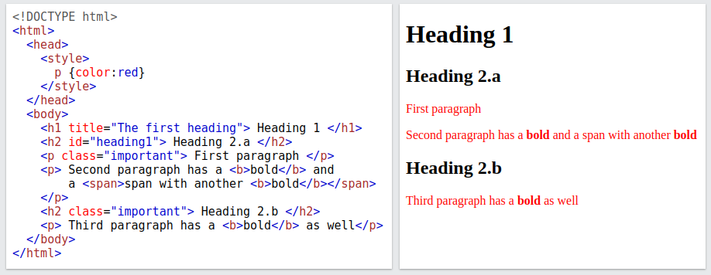
Element selector: element
An element selector matches one specific type of element.
For example, matching on p results in all <p> elements being highlighted.
body
h1
h2
b
p
b
h2
p
p
b
span

Slide 15
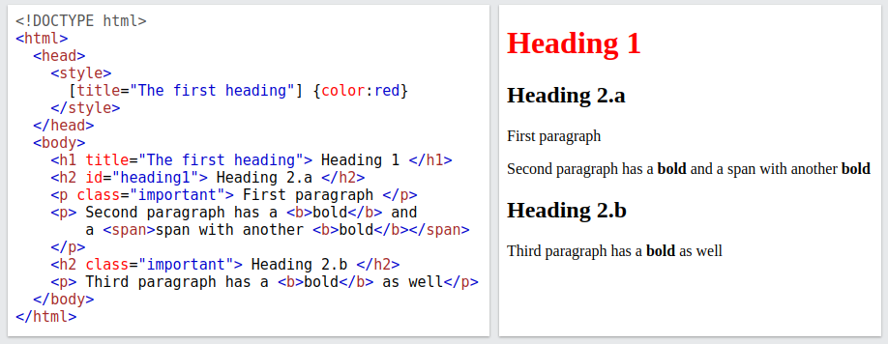
Attribute selector: [attribute=value]
An attribute selector matches on any element that has a given attribute with the specified value.
The value may be omitted to select elements with that attribute with any value.
For example, matching on the attribute [title="The first heading"] results in:
body
h1
h2
b
p
b
h2
p
p
b
span

Slide 16
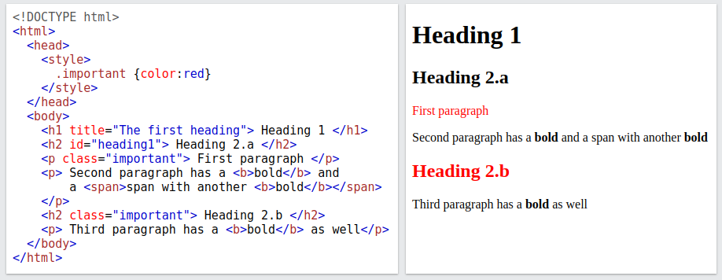
Class selector: .class
Class selectors allow the grouping of a set of elements (that may not even use the same tag).
The class is set using the special class attribute.
For example, matching on the class .important results in:
body
h1
h2
b
p
b
h2
p
p
b
span

Slide 17
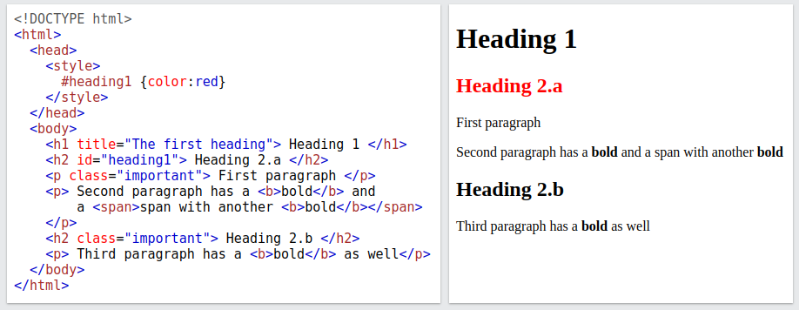
Id selector: #id
An id selector selects an element with the special id attribute.
Unlike class where each value can occur on many tags, each id value must only occur on a single tag the document, e.g. so they can be referenced in the URL and used for navigation.
Matching on #heading1 results in:
body
h1
h2
b
p
b
h2
p
p
b
span

Slide 18
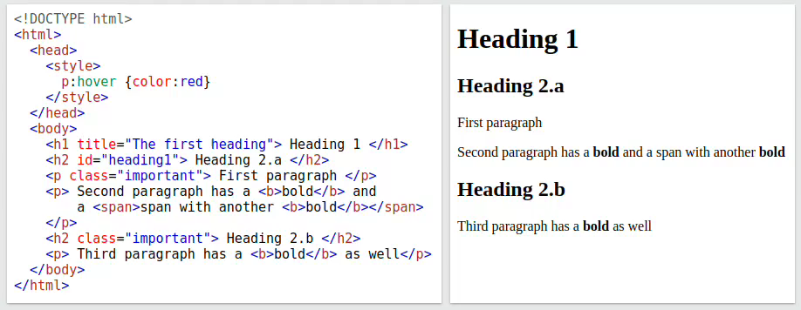
Pseudo-class selector: :state
Pseudo-class selectors allow selecting elements based on their state (e.g. hover, focus, valid, visited)
For example, matching on the class p:hover results in the paragraph elements being highlighted when you hover over them:
body
h1
h2
b
p
b
h2
p
p
b
span

Slide 19
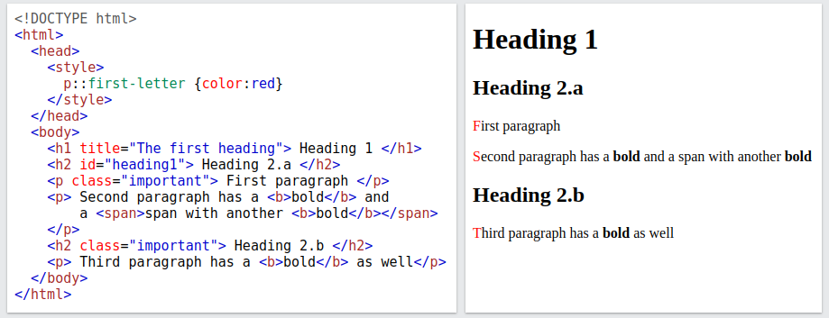
Pseudo-element selector: ::pseudo-element
Pseudo-element selectors allow you style a specific part of an element (e.g. first-line, first-letter, backdrop)
For example, matching on the class p:first-letter results in the first letter of each paragraph elements being highlighted.
body
h1
h2
b
p
b
h2
p
p
b
span

Slide 20
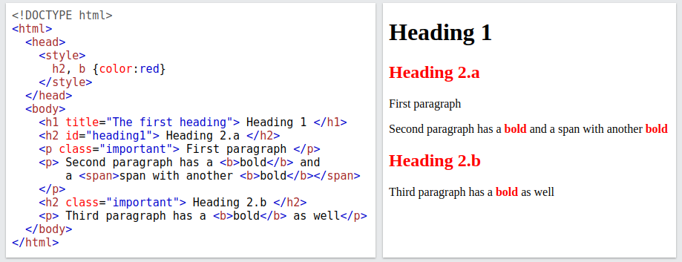
Group selector: s1, s2
Group selector s1,s2 act as a logical or, applying the style to elements that match either s1 or s2.
For example, matching on h2,b results in both level 2 headers and bold text being selected:
body
h1
h2
b
p
b
h2
p
p
b
span

Slide 21
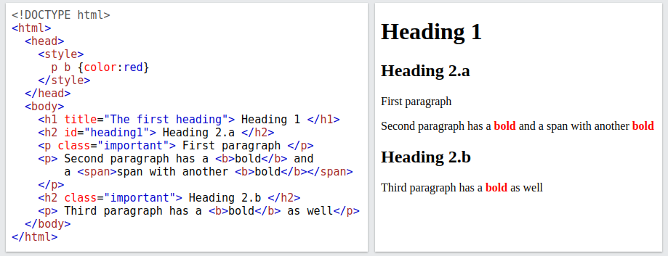
Descendent selector: s1 s2
The descendant selector s1 s2 selects anything that matches s2 that is below something that matches s1 in the tree.
For example, matching on p b results in every bold element below a paragraph element to be selected.
body
h1
h2
b
p
b
h2
p
p
b
span

Slide 22
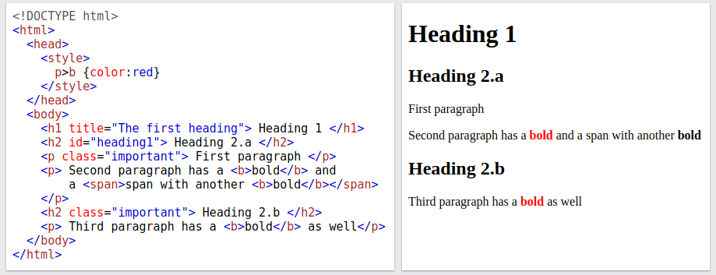
Direct descendent selector: s1>s2
The direct descendant selector s1>s2 selects anything that matches s2 that is directly below something that matches s1 in the tree.
For example, matching on p>b results in every bold element directly below a paragraph element to be selected.
body
h1
h2
b
p
b
h2
p
p
b
span

Slide 23
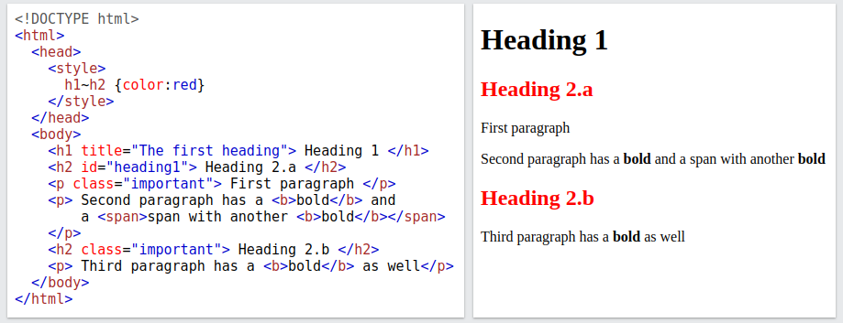
Sibling selector: s1~s2
The sibling selector s1~s2 selects anything that matches s2 that shares a parent with something that matches s1 in the tree.
For example, matching on h1~h2 results in every h2 element to the right of a h1 element being selected.
body
h1
h2
b
p
b
h2
p
p
b
span

Slide 24
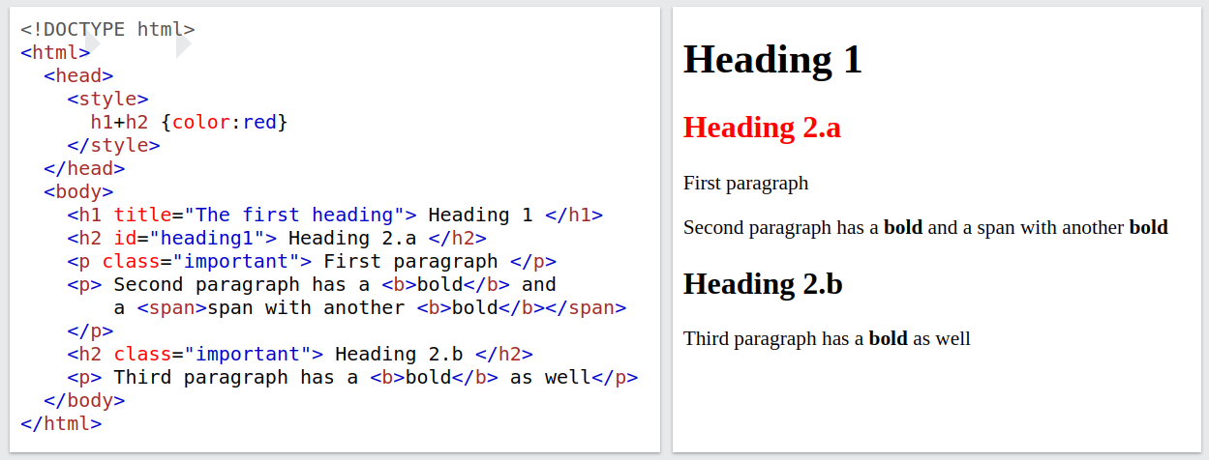
Direct sibling selector: s1+s2
The direct sibling selector s1+s2 selects anything that matches s2 that is the next child along of something that matches s1 in the tree.
For example, matching on h1+h2 results in every h2 element directly to the right of a h1 element being selected.
body
h1
h2
b
p
b
h2
p
p
b
span

Slide 25
Conflict resolution
An element may be the subject of more than one rule because:
A tag may be used twice as a selector.
A tag may inherit a property and be used as a selector.
This is often unavoidable as your page will invariably contain multiple style sheets with conflicting definitions:
User style sheets, (style sheets written by the user via the browser settings)
Author style sheets (style sheets used by the developer)
User agent style sheets (default style sheets provided by the browser)
CSS priority can be overridden by the !important modifier.
Notes:
what happens when you have multiple version of styles
CSS standard provides an incredibly complicated procedure for resolving conflicts
More specific the better because it narrow downs your target.

Slide 26
(Simplified) precedence rules
First break ties by origin and importance:
Transition declarations (used for animation, not covered)
Important user agent declarations
Important user declarations
Important author declarations
Normal author declarations
Normal user declarations
Normal user agent declarations
If still tied, then judge on specificity:
Inline styles > style sheet styles
Number of IDs in selector
Number of classes, attributes and pseudo-classes in selector
Number of type and pseudo-elements in selector
If still tied, then choose whichever selector appears last.
Full rules available at: https://www.w3.org/TR/css-cascade-3/
Notes:
To resolve CSS conflicts, you first break ties by origin and importance. The highest priority goes to transition declarations used in animations. This means that during animations, styles applied at specific frames temporarily override all other styles because they are essential for the animation to work properly.
More specific the better because it narrow downs your target.
So the next time you’re debugging a CSS conflict, follow the 3-step process:
Origin — who wrote the rule?
Specificity — how strong is the selector?
Order — which one came last?
And remember, !important is your trump card — but use it wisely!”

Slide 27
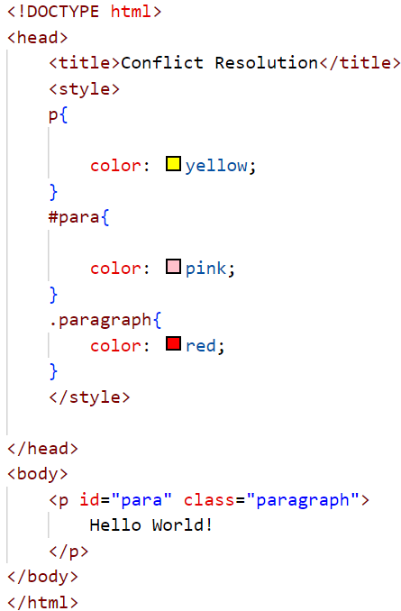
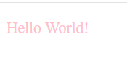
Conflict resolution ( IDs vs. Classes vs. Elements )

Slide 28
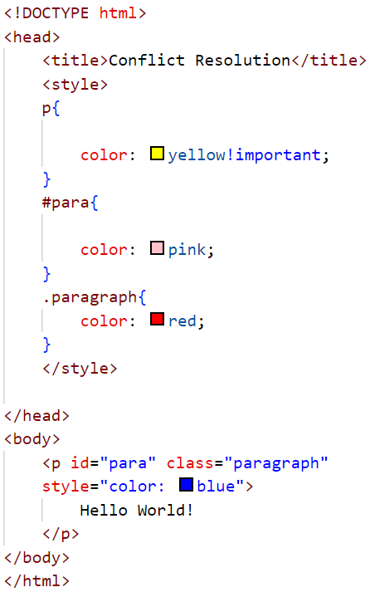

Conflict resolution ( Inline vs. !Important)

Slide 29
CSS properties
Notes:
29

Slide 30
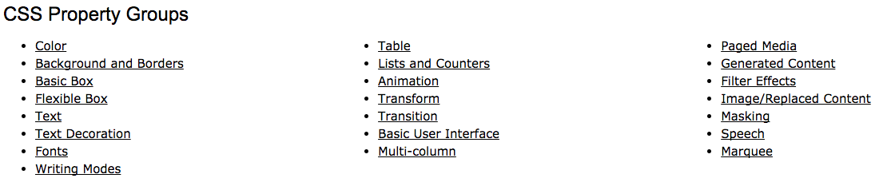
Property groups
There are many, many CSS properties and the list is continually growing.
The basic ones we will cover are:
text
background
borders
the box model
colors
tables
lists

Slide 31
Font properties
font-size – values: a number or a name, such as smaller, xx-large, etc.
font-style – values: italic, normal
font-weight – degrees of boldness
can specify as one of: bolder, lighter, bold, normal
can specify as a multiple of 100 (100 – 900)
font
For specifying a list of font properties at the same time
font: bolder 14pt Arial Helvetica
Order must be style, weight, size, name(s)
text-decoration – values: line-through, overline, underline, none
letter-spacing – values: any number

Slide 32

Text alignment
The text-indent property allows indentation:
Takes either a length or a % value
The text-align property has 4 possible values:
left (the default), center, right, or justify
Sometimes we want text to flow around another element - the float property
The float property has the possible values, left, right, and none (the default)
If we have an element we want on the right, with text flowing on its left, we use the default text-align value (left) for the text and the right value for float on the element we want on the right
<img src="c210.jpg” style="float: right"/>
Some text with the default alignment - left

Slide 33
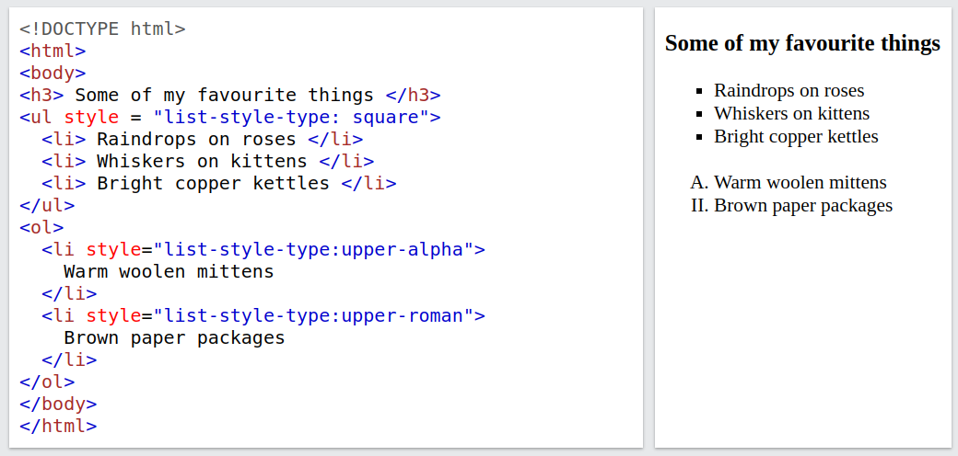
List properties
The list-style-type property sets the marker type used for <li> elements.
When set on the <ul>/<ol> element, the style applies to all <li> elements in the list.
When set on the individual <li> element it applies only to that element.
Possible values:
Unordered list: disc, square, circle, none etc.
Ordered list: decimal, upper-alpha, upper-roman, etc.

Slide 34
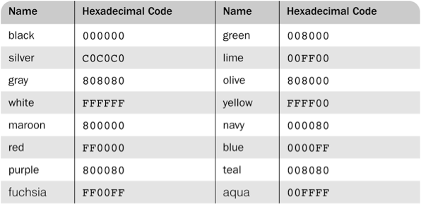
Colours
The color property specifies the foreground colour of element
There are three colour collections:
There is a set of 16 colours that are guaranteed to be displayable by all graphical browsers on all colour monitors:
There is a much larger set of 140 named colours supported by all major browsers: https://www.w3schools.com/cssref/css_colors.php
Any one of 16 million different colours
#000000, #000001, #000002, . . . , #FFFFFE, #FFFFFF

Slide 35
CSS layout
Notes:
35

Slide 36
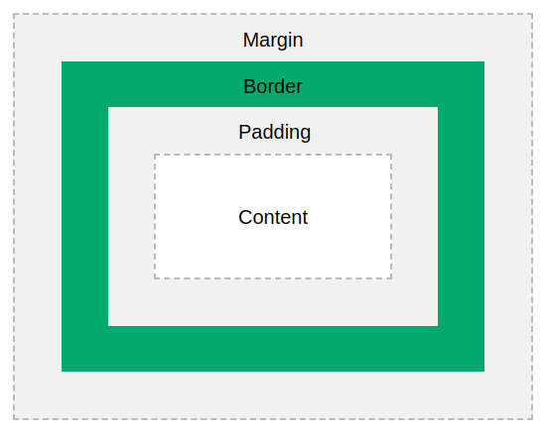
The Box model
Every element is essentially laid out as four boxes which is known as the box model.
It is used to control the spacing and borders around an element on the page.
The content is where the actual element is rendered.

Slide 37
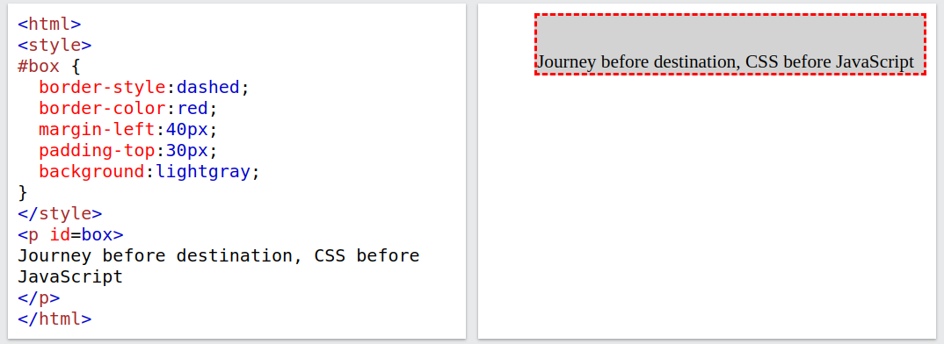
The Box model – margin and border
The margin of an element is the space between its border and its neighboring element.
The margin is always transparent, and its size can be set with margin, margin-left, margin-top, ...
The border of an element can be set using the following properties:
border-style: none (default), dotted, dashed, etc.
border-width: thin, medium (default), thick, or a length value in pixels
border-color: any colour

Slide 38
The Box model - padding and sizes
The padding of an element is the space between its border and its content.
The margin is always transparent, and its size can be set with padding, padding-left, padding-top, …
When you set the width and height properties of an element with CSS, you (normally) just set the width and height of the content area.
To calculate the total width and height of an element, you must also include the padding and borders.
The margin property also affects the total space that the box will take up on the page, but the margin is not included in the actual size of the box. The box's total width and height stops at the border.

Slide 39
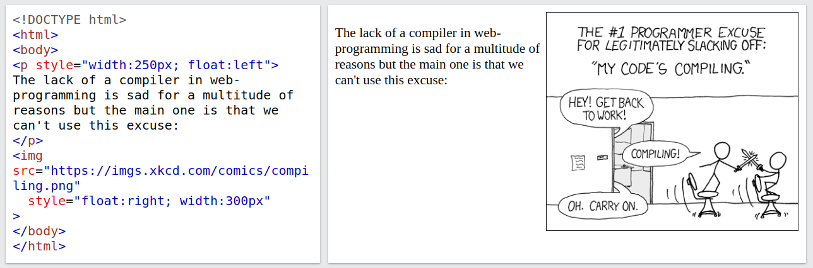
Document flow and the float property
By default, elements are laid out according to the normal flow of the document – they appear sequentially above each other in the order they are declared.
There are three ways of overriding the normal flow.
1. The float property
The element is laid out according to the normal flow, then shifted to lie to the left or right of the previous element.
There are three values: none, left, right, inherit
Used to e.g., have images and text on the same line.
Relative Positioning
If no top and left properties are specified, the element is placed exactly where it would have been placed if no position property were given
But it can be moved later using JavaScript
<p> This is some text.
<span style=“position:relative; top: -1em> Up we go!</span> Here is some more text.
</p>

Slide 40
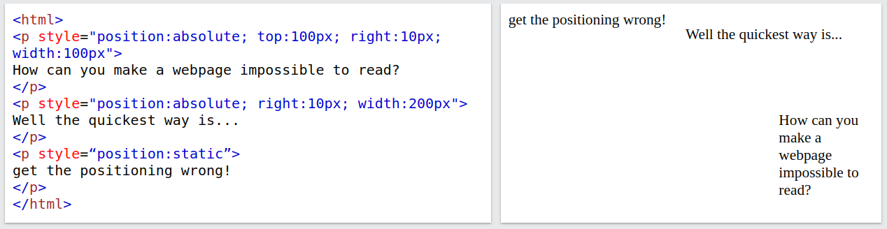
Position property
2. The position property
Uses the offset properties: top, left, right, bottom
There are five value:
static - (default) - go with the normal flow
relative – the element is offset relative to its normal flow position, but the element is not removed from the flow.
absolute – the element is offset relative to its most recently positioned ancestor. The element is removed entirely from normal flow.
fixed - the element is offset relative to the fixed viewport. The element is removed entirely from normal flow.
sticky - switches between relative and fixed depending on the scroll position.

Slide 41
Position property and frameworks
3. The display property determines how the element is treated in normal flow
There are ~20 possible values:
block, inline, flex, grid, inline-flex, etc.
Won't go into detail here but see various tutorials online.
A much more scalable way is to use a CSS framework which are libraries of CSS code allowing you to quickly build a visually appealing and responsive website.
See next Lecture for more details.
Laying out your webpage manually with raw CSS is hard!​ Furthermore you must consider how the webpage looks across many different screen types and sizes.
​

Slide 42
Other
Notes:
42

Slide 43
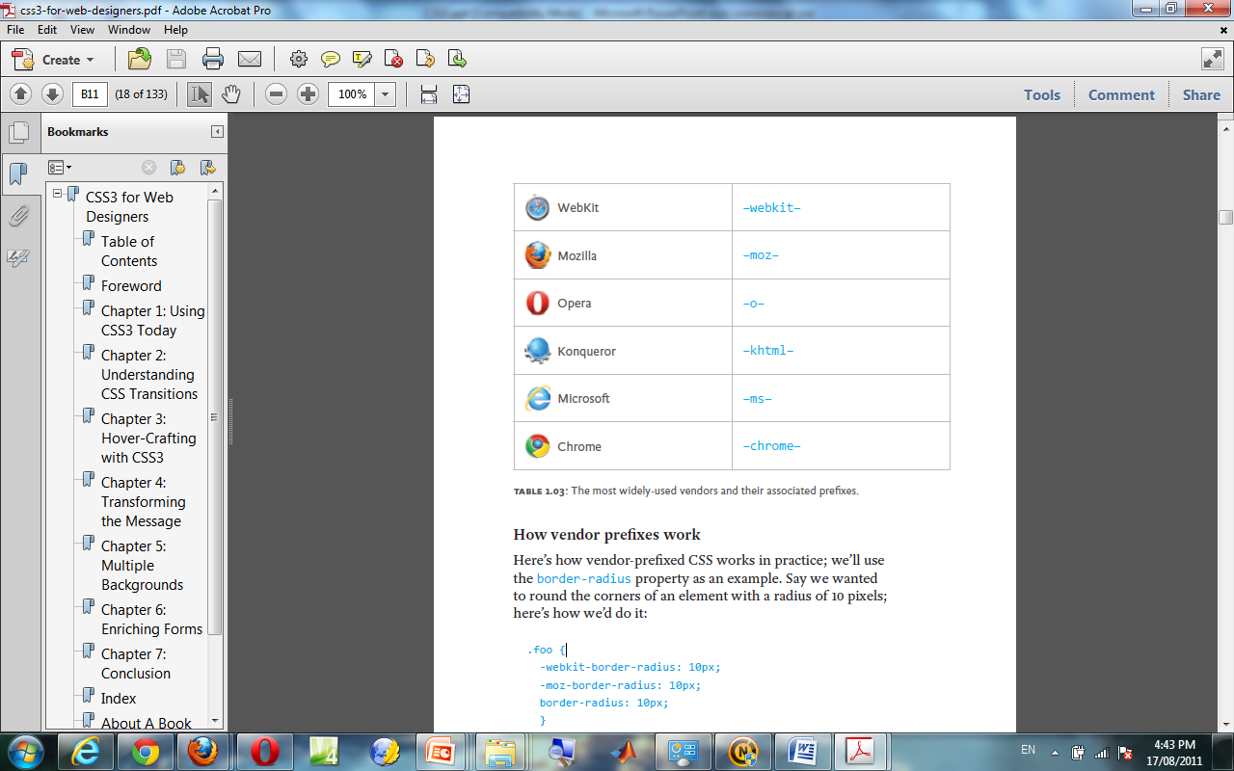
Vendor prefixes
A positive catalyst for the evolution to exciting technologies
“… force the vendors and the Working Group to work together to devise the tests necessary to determine interoperability. Those tests can then guide those who follow, helping them to achieve interoperable status much faster. They could literally ship the prefixed implementation in one public beta and drop the prefix in the next.”
.foo {
-webkit-border-radius: 10px;
-moz-border-radius: 10px;
border-radius: 10px;
}

Slide 44
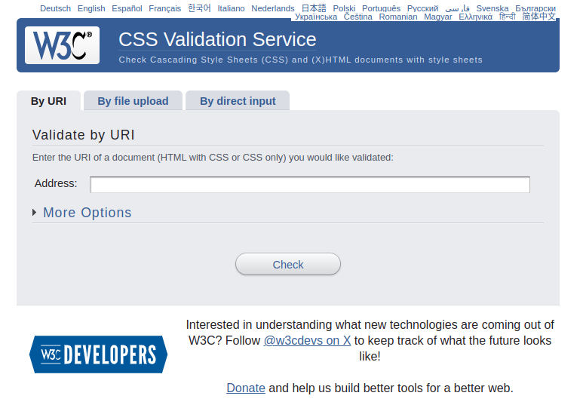
Validating CSS

Slide 45


CSS is boring...
You can build some amazing things with pure CSS:
https://codepen.io/r4ms3s/pen/gajVBG
https://codepen.io/stepan/pen/NWmqdW

